Slide 1
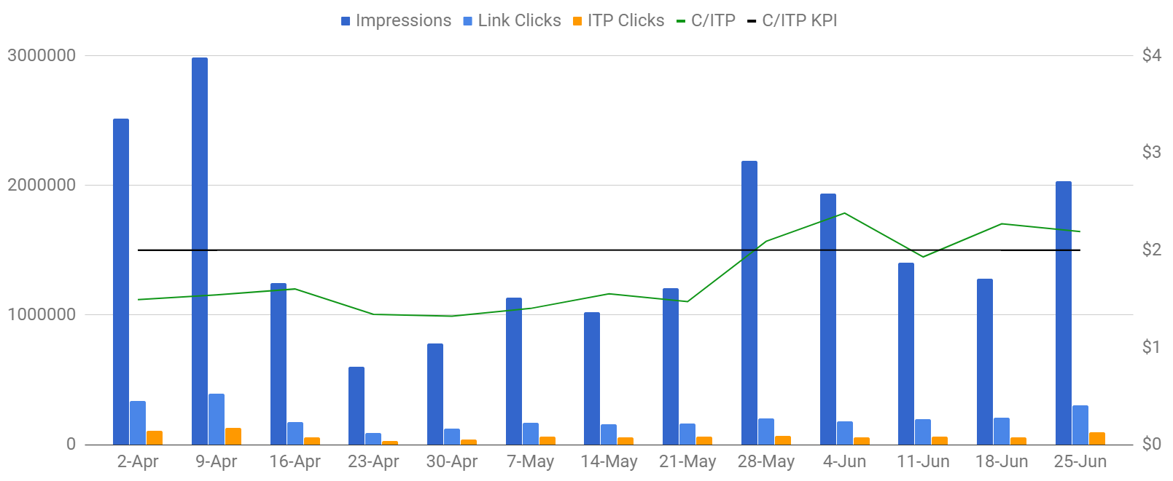
PERFORMANCE TRENDING
<Campaign 1>
Flight: April 1st to June 30th 2019
Total Cost: $ 153,039.93 (+69.82% YoY)
Total Impressions: 20,329,836 (+18.01% YoY)
Total Clicks: 268,762 (-37.38% YoY)
Total ITP Conversions: 87,583 (+451.23% YoY)
Total CTR: 1.31% (-1.16% YoY)
Total CPA: $ 1.75 (-69.19% YoY)
Revenue: $ xxx (+xxx% ROI)
INSIGHTS
After seeing increased CPMs (20% higher than normal setup) on Facebook's auto campaign optimization feature on the earlier part of the quarter, we have reverted to the standard setup.
CPA started to climb towards June, which was caused by two new campaign launches: Campaign 1 and Campaign 2. The first campaign did not perform as expected, as it finished with a CPA much higher than Arlo Pro 2, at $13.10. This can be attributed to several factors, but based on the data it resulted from a 78% higher CPM and and a notably low click-to-convert ratio of 5% (Campaign XX is at 36%).
The Reach and Frequency campaign was launched later in May with the goal of increasing brand awareness for the Arlo Pro 2 product. During the duration of this campaign, we saw a 12% improvement on the main campaign’s CPM (compared to the weeks prior to launch), while retaining the CPC and CPA.
Majority of the conversions have come in from the lookalike targeting segments at 86%, with the website ITP lookalike audience spending 35% of the budget for the quarter, at a relatively low CPA.
RECOMMENDATIONS
To improve the performance on the 1st campaign, we must create solutions for each possible factor that may have contributed. We’ll be looking further on additional audiences to lower CPM and increase click through rate, but we’ll still need to drive users to a proper landing page (quick loading time, cohesive content to conversion, correct tracking).
With the Opt-In lookalike audience having the best CPA for the quarter ($1.45), we’d recommend updating the base email list to improve the accuracy of the generated lookalike segment.

Slide 2
SOCIAL
TOP PERFORMERS
CPC: $0.29
CPA: $1.28
Text: Alexa Integration
Title: Full HD Resolution
Description: Security
Use Case: Alexa Integration
Animation: Animation
Gender:
    Male: 80%
    Female: 20%
AGE
    25-34: 12%
    35-44: 19%
    45-54: 25%
    55-64: 25%
    65+: 19%
Operating System:
    iOS: 55%
    Android: 33%
    Desktop: 12%
Top 5 Regions:
    Florida: 9%
    Texas: 8%
    California: 8%
    New York: 5%
    Pennsylvania: 4%
Day of Week:
    Sunday: 15%
    Monday: 13%
    Tuesday: 15%
    Wednesday: 15%
    Thursday: 13%
    Friday: 13%
    Saturday: 15%
BEST
CPC: $4.98
CPA: $27.38
WORST

Slide 3
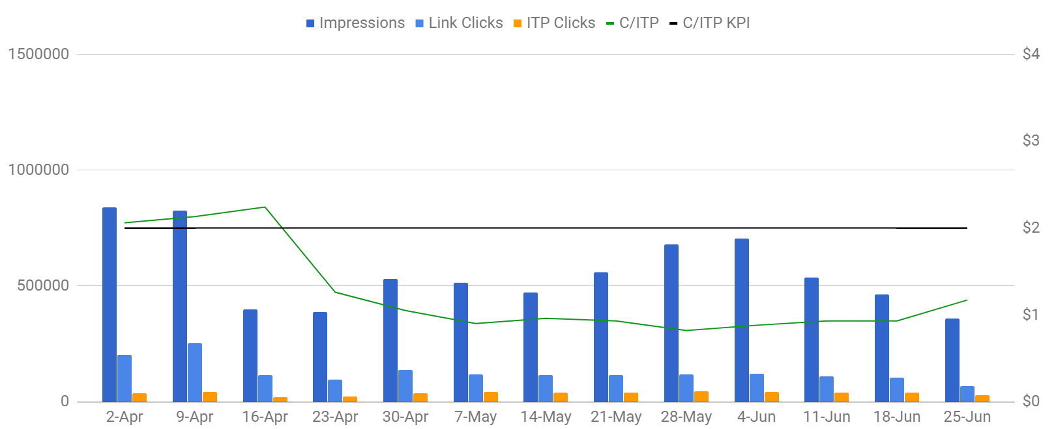
PERFORMANCE TRENDING
<Campaign 2>
Flight: April 1st to June 30th 2019
Total Cost: $ 56,490.00 (+367.28% YoY)
Total Impressions: 7,259,787 (+237.70% YoY)
Total Clicks: 166,628 (+176.98% YoY)
Total ITP Conversions: 47,231 (+298.84% YoY)
Total CTR: 2.30% (-0.50% YoY)
Total CPA: $1.20 (+17.16% YoY)
Revenue: $ xxx (+xxx% ROI)
INSIGHTS
The campaign was part of the test conducted earlier in the quarter on Facebook's auto campaign optimization feature. There was no discernable improvement in terms of CPA, but CPM is higher by 33%.
Spend was reduced for the weeks following the test, and began scaling spend based on audience performance once we were able to get excellent CPA levels, and even boosting impressions towards the end of May.
Lookalike audiences dominated performance for this quarter, generating 92% of the total ITP clicks. From these targeting groups, the Opt-In lookalikes have shown the lowest CPA of $1.03, and the highest click-to-convert ratio of 39%.
Both Photo and Video ad types have contributed to keeping the low CPA for the quarter.In terms of impressions and conversions, Photo ads have outperformed Video ads (31% lower CPM, 16% lower CPA). On the other hand, Video ads are more efficient for clicks (26% lower CPC, 96% higher CTR)
Aside from the audience and ad optimizations, the shift of focus to the new landing page with its high click-to-convert ratio (28% for Q2) helped to improve CPA by 26% QoQ.
RECOMMENDATIONS
After seeing the campaign maintain excellent CPA on increased weekly spend, there is huge potential on increasing the total quarterly budget. Based on the Q2 performance, we are capable of spending up to 35% more whilst hitting the campaign KPI.
As Product 2 is for more specific audiences, we have the opportunity to conduct a test on ad messaging. Having new ads that are tailored to our top performing audiences (Neighborhood Watch, Construction, Farm) would be beneficial for the campaign.

Slide 4
SOCIAL
TOP PERFORMERS
CPC: $0.30
CPA: $1.04
Text: Construction Focus
Title: No WiFi? No Problem
Description: Every Angle Covered
Use Case: Security
Animation: Static
Gender:
    Male: 73%
    Female: 26%
AGE
    18-24: 2%
    25-34: 5%
    35-44: 10%
    45-54: 19%
    55-64: 33%
    65+: 32%
Operating System:
    iOS: 55%
    Android: 33%
    Desktop: 10%
Top 5 Regions:
    Texas: 10%
    Florida: 9%
    California: 9%
    New York: 5%
    Georgia: 4%
Day of Week:
    Sunday: 15%
    Monday: 14%
    Tuesday: 14%
    Wednesday: 14%
    Thursday: 14%
    Friday: 13%
    Saturday: 15%
BEST
CPC: $0.45
CPA: $1.54
WORST

